Slide 1
Microsoft asp.net MVC
AMAL DEV

Slide 2
agenda
Introduction
History
Why ASP.NET MVC & Why Not ASP.NET Web Forms ?
How it works ?
Tooling & Setting Up Environment
One ASP.NET
Hello MVC - Demo

Slide 3
WhAT IS mvc ?
MVC – Model - View – Controller
Separates application logic from presentation logic, loose coupling between components.
MODEL
CONTROLLER
USER
VIEW
Model
Handles data and business logic
updates
manipulates
View
Presents data to user
Controller
Receives requests, process model and produces the view
sees
uses
Notes:
Model : represents the data model, manages behaviour and data of the application domain
View : represents the screen shown to the user
Controller : interprets the requests from the user and produces the output to the view by processing the model

Slide 4
Down the memory lane…
Classic ASP
ASP.NET
ASP.NET MVC 1.0 – March, 2009
.NET 3.5, Visual Studio 2008, MVC pattern architecture with Web Forms as view engine
HTML Helpers, Ajax Helpers
ASP.NET MVC 2.0 – March, 2010
.NET 3.5, 4.0, Visual Studio 2008, 2010, Client Side Validation, Data Annotations, Areas
Templating Engine, Async Controllers
Notes:
Most of the sites were based on php and perl scritps, generated spagetti code(mixture of server side and html). Application code and presentation logic was in the same page, enterprise relied on frameworks such as coldfusion and java servlets
was very similar to php, used VBScript or Jscript for client side scripting, enabled devs to invoke ActiveX COM objects
Based on .net framework, provided a windows-form like abstraction, event based dev environment
advantages – shorter learning curve, good ui designer with drag and drop, event based programming model
disadv – limited to one form tag, even changing a value in drop down with autopostback slow round trip coz page needs to be completely rendered.
manitaing state with viewstate became a pain as no of controls in the page went up, GUI designer generated poor mark up
Mvc 2.0
model validation based on attributes, both client and server side
Areas to parition application into modules
Templating – to automatically generate forms based on the mode and attributes

Slide 5
Down the memory lane…
ASP.NET MVC 3.0 – January, 2011
.NET 4.0, Visual Studio 2010, Razor View Engine, EF Code First Support, ViewBag
Global Filters, Dependency Resolver, nuGet support
ASP.NET MVC 4.0 – August, 2012
.NET 4.0, 4.5, Visual Studio 2010 SP1, 2012, ASP.NET Web API, Mobile Project Template
Bundling & Minification, Support for Azure SDK
ASP.NET MVC 5.0 – October 2013
.NET 4.5, 4.5.1 Visual Studio 2013, One ASP.NET, ASP.NET Web API 2
Bootstrap Support, Authentication Filters
ASP.NET MVC 6.0 – On the way….

Slide 6
Why ASP.NET MVC & Why Not ASP.NET Web Forms ?
ASP.NET Web Forms
ASP.NET MVC
Page Controller Pattern
Tightly Coupled
Automated Testing is difficult
ViewState
Limited control over HTML/CSS/JS
Server Controls
Front Controller Pattern
Loosely Coupled
Easy to do Automated Testing
ViewState is not available
Full control over HTML/CSS/JS
HTML Helpers
Notes:
Every page has its own controller, ie code behind
Common controller for all pages tp process the requests
2. No separation of concerns, tightly coupled with aspx and cs files, Clean seperation, View and Controller are loosely coupled and can be reused independently
3. Due to tight coupling automated testing is very difficult where as with loose coupling we can create automated test for views and controller very easily and TDD is very simple
4. To simulate win forms like behaviour ViewState was used to maintain state for stateless web. Has lot of problems like as controls in the page grows, viewstate also increases in size which affects the performance. With MVC, the patterns follows the stateless web approach and hence no viewstate is needed
5.

Slide 7
How it works ?
Controller asks for data
Model
2
Request hits the controller
Applies domain logic and gives data back
Browser
Controller
3
1
Formats data and passes the model
4
Renders HTML and sends back response
5
View

Slide 8
What happens inside ?
Request
MVC Handler
Controller Action Invoker
Controller Factory
Action Result
View Engine
View
Routing
Action Filters
Model Binders
Response
Notes:
IIS determines that request needs to be processed by ASP.NET
URL Routing module process the request as any standard http module, looks for the route table defined in the project and dissects the request.
If it founds the pattern matching then it invokes IHttpHandler using the GetHttpHandler. For MVC the default route handler is the MVCRouteHandler.
3. GetHttpHandler returns MVC Handler which is responsible for actual processing of the requet and generating the response.
4. MVC Handlers uses IControllerFactory instance to the get the IController object, it has an execute method which executes our action method. All our controllers should inherit IController
5. Once the controller is instantiated, ActionInvoker determines which action needs to be executed, while executing the action method it will looks for any filters that needs to executed before and after action execution and will look for any custom model binders being specified
6. The output of the Action method is the Action result object. An action method always returns Action Result type. Action result can be ViewResult, JsonResult, HttpResult etc
7. The action result is then passed to the View engine to render the result, View Engines provided by framework are razor and web forms
8. The view engine these emits the html by parsing the ActionResult and sends the response back to the browser

Slide 9
Tooling & Setting up Environment
Visual Studio Express 2013 for Web/Visual Studio Community 2013/Visual Studio Ultimate 2013
.NET 4.5
IIS(optional)
Windows 7 or higher

Slide 10
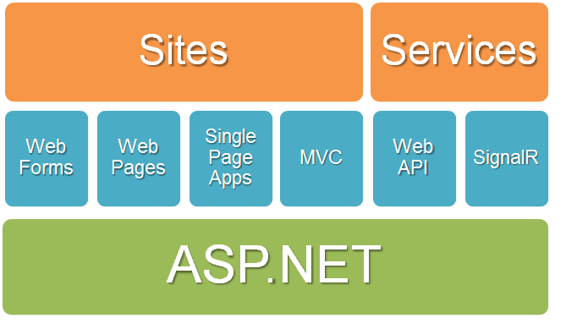
One asp.net

Slide 11
Hello MVC - DEMO

Slide 12
QUESTIONS ???

Slide 13
THANK YOU
AMAL DEV

